Slide 1

Introduction to Generative AI
Generative AI is a powerful technology with exciting potential to revolutionize many industries. It's a branch of artificial intelligence that focuses on creating new content, like images, text, audio, or even code.

Slide 2

What is Generative AI?
Generative AI systems learn from vast amounts of data and then use that knowledge to generate new, original outputs that are similar to the data they were trained on. This process is driven by algorithms that understand the patterns and relationships within the data.
Image Generation
Text Generation
Audio Generation
Creating photorealistic images or artistic illustrations.
Writing stories, articles, poems, or code.
Composing music, generating sound effects, or creating realistic speech.

Slide 3

How does Generative AI work?
Generative AI relies on deep learning, a type of machine learning that uses artificial neural networks to mimic the way human brains learn. These networks are trained on massive datasets, allowing them to identify patterns and relationships within the data.
1
Training
The AI model is trained on a vast dataset, learning the underlying patterns and structures.
2
Generation
The trained model uses its learned knowledge to generate new outputs similar to the training data.
3
Evaluation
The generated output is evaluated based on its quality, originality, and relevance to the desired task.

Slide 4

Key Capabilities of Generative AI
Generative AI offers a range of capabilities, enabling it to perform tasks that were once thought to be exclusive to humans.
1
Creativity and Innovation
2
Personalization and Customization
3
Efficiency and Automation
Creating original and unique content that pushes the boundaries of human imagination.
Generating content tailored to individual preferences and needs.
Automating content creation tasks, freeing up human time and resources for more strategic endeavors.

Slide 5
Applications of Generative AI
Generative AI is finding its way into various industries, transforming the way we work and live.
Art and Design
Content Creation
Healthcare
Creating stunning visuals, from realistic images to abstract art.
Writing articles, generating social media posts, composing music.
Developing personalized treatments, generating synthetic medical data for research.

Slide 6




Advantages of Generative AI
Generative AI offers numerous advantages, making it a transformative force in various fields.
Increased Efficiency
Automating tasks, allowing humans to focus on more strategic initiatives.
Enhanced Creativity
Generating novel ideas and concepts, pushing the boundaries of imagination.
Accelerated Innovation
Developing new solutions and breakthroughs at a faster pace.

Slide 7
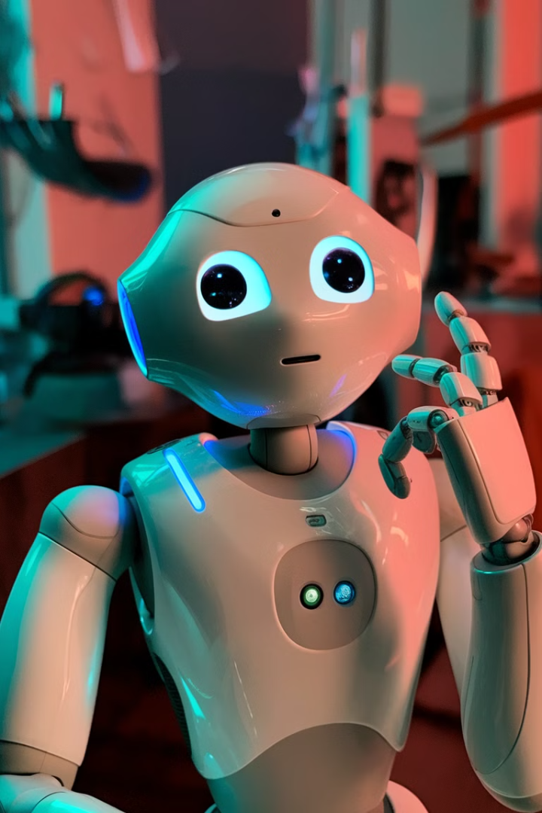



Challenges and Limitations
While generative AI holds immense promise, it also comes with challenges and limitations that need to be addressed.
Bias and Fairness
AI models can inherit biases from the data they are trained on, leading to unfair or discriminatory outputs.
Ethical Concerns
The misuse of generative AI, such as creating deepfakes or generating harmful content, raises ethical dilemmas.
Lack of Explainability
Understanding how generative AI models arrive at their outputs can be difficult, making it challenging to assess their reliability and trustworthiness.

Slide 8

The Future of Generative AI
Generative AI is a rapidly evolving field with a bright future. As technology continues to advance, we can expect to see even more groundbreaking applications and advancements in this field.
Increased Realism and Sophistication
Generating more realistic and high-quality content, blurring the lines between real and artificial.
Wider Accessibility
Making generative AI tools available to a broader audience, empowering individuals and organizations to leverage its capabilities.
Integration with Other Technologies
Combining generative AI with other emerging technologies, such as the metaverse and blockchain, to create novel experiences and solutions.

Slide 9

Q&A and discussion
Let's discuss the potential and implications of AI.
1.What does it mean for AI to "generate" content?
2.What is the role of training data in Generative AI?
3.How is Generative AI used in natural language processing?

